Slide 1
Logo Creation Guideline
And Asset Package

Slide 2
Content
In this packet you will find:
Instruction guide (this document)
ABAI icons of various colors

Slide 3
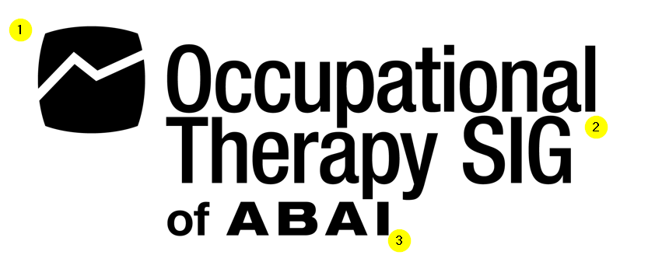
Design Guideline
The logo should consist of only 4 elements
The ABAI icon
The icon must not be altered in any way except resizing to fit the overall logo design
The name of the constituent group
The text “of ABAI”
And an optional representation of the constituents
The image below shows an example of the first 3 requirements:

Slide 4
Design Specifications - Placement
Placement of the logo elements are as follows:
ABAI icon to the left of all text and align closer to the top
The name of the constituent group is place above “of ABAI” to the right of the icon
And finally “of ABAI” is place below the name of the group as shown below.

Slide 5
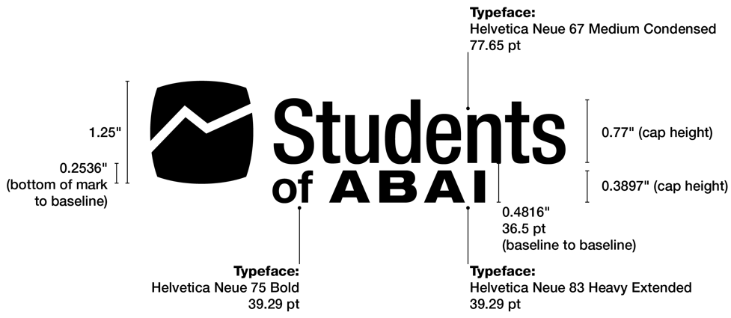
Design Specifications - Font
The recommended font and sizes are as shown:
You can also use these alternate fonts:
Helvetica
Aptos
Roboto Condensed

Slide 6
Examples
These are some example of acceptable logos. It may not represent actual constituent groups.
Montana SIG
of ABAI

